Slide 1

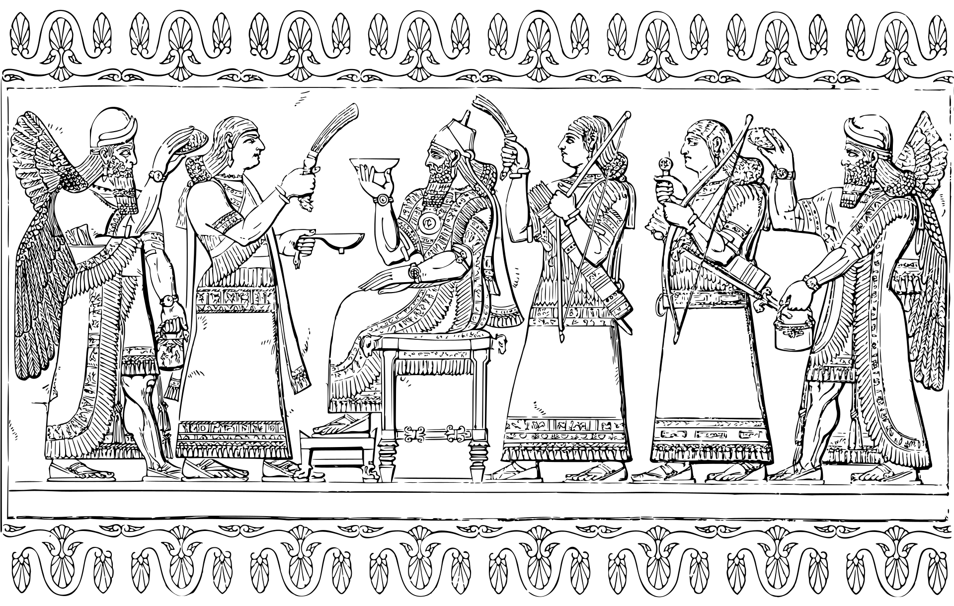
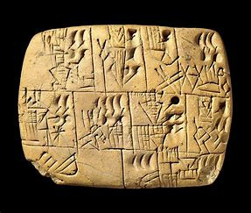
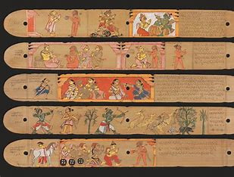

Script's
Launguage
by:
Bharath Kumar J
Anup Chakma
1

Slide 2

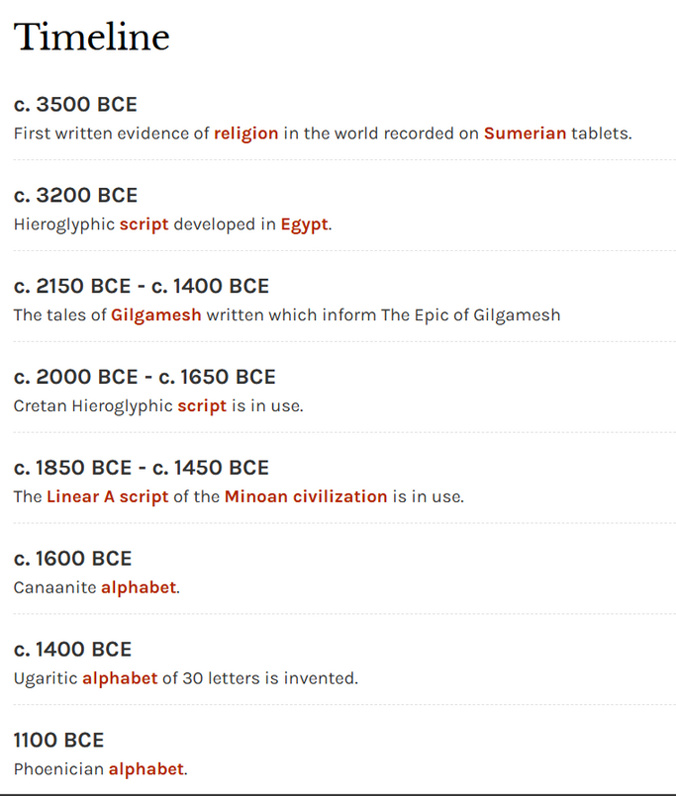
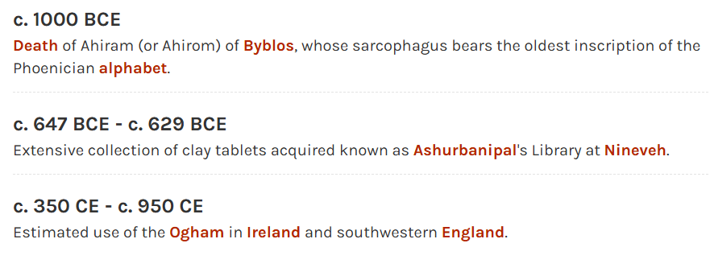
Script Time-line
Credicts:
https://www.worldhistory.org/timeline/script/
2

Slide 3
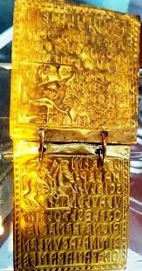
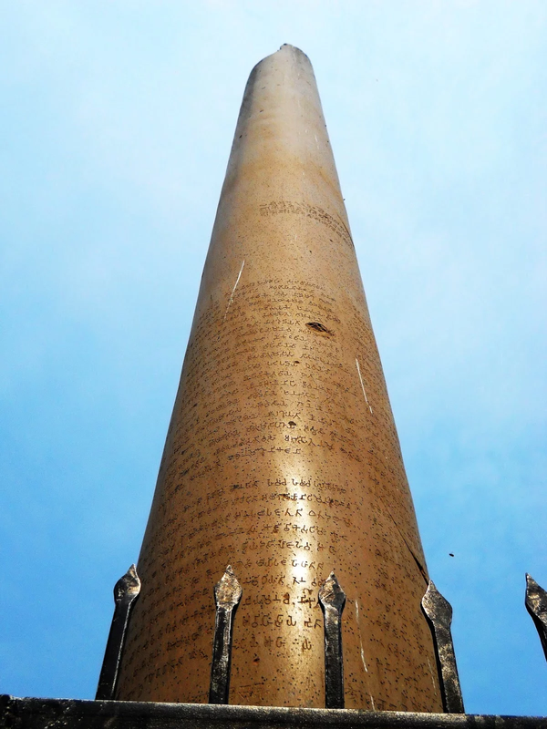
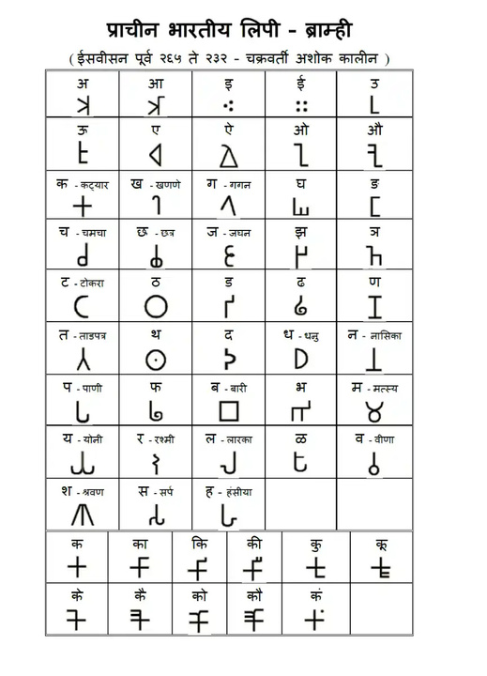
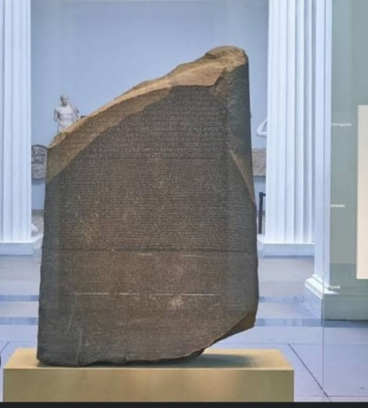
Scripts
Ashoka Pillar
Bhrami Script
Etruscan Gold Book
Rosetta Stone
3

Slide 4
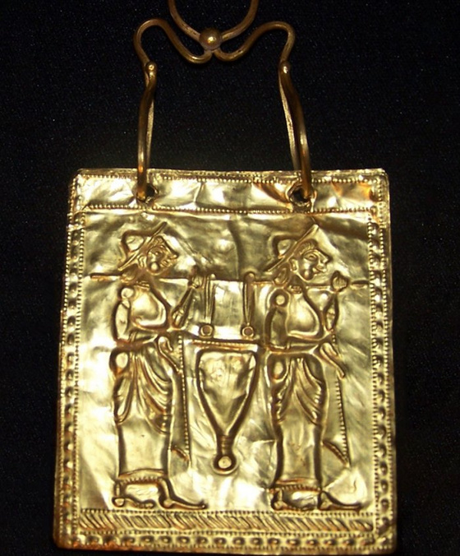
Golden ‘Etruscan’ Orphic Book – Six Golden Pages Of The Oldest Book In History Of Mankind
A small book was found in an old tomb covered with frescoes. It is the world's oldest book in the history of humankind, made of gold and dated to 600 BC.
The illustrated six golden pages are made of 23.82-karat gold (measuring 5 centimeters in length and 4.5 centimeters in width) and fastened together with gold rings. The pages are covered with text and decorated with images of warriors, a horseman, a siren, and a lyre.
Credicts:
https://www.ancientpages.com/2020/03/27/golden-etruscan-orphic-book-six-golden-pages-of-the-oldest-book-in-history-of-mankind/
4

Slide 5
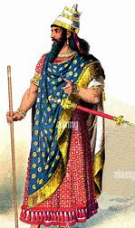
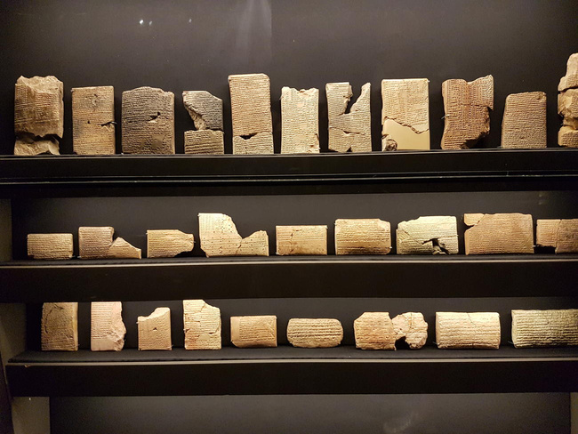
Assyrian king
The Assyrian king in 7th century created library
containing 30,000 cuneiform Tablets
Ancient Mesopotamian kingdom of Assyria, which was founded in the late 21st century.Located in the city of Nineveh, in present-day Iraq, this library was built by King Ashurbanipal, the last great king of the Neo-Assyrian Empire, in the 7th century BC.
King Ashurbanipal
Credicts:
https://facts.net/world/landmarks/9-extraordinary-facts-about-the-library-of-ashurbanipal/
5

Slide 6
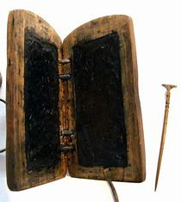
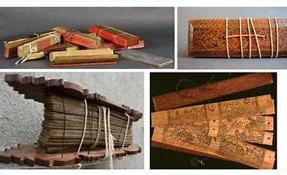
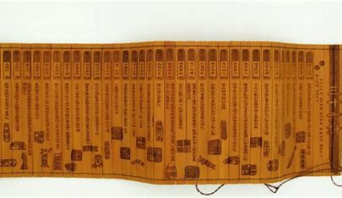
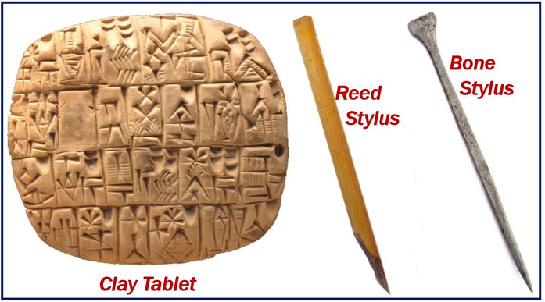
Materilas Used to write
Bamboo Strips
Wax Tablets
Palm Manuscripts
Clay Tablet
6

Slide 7


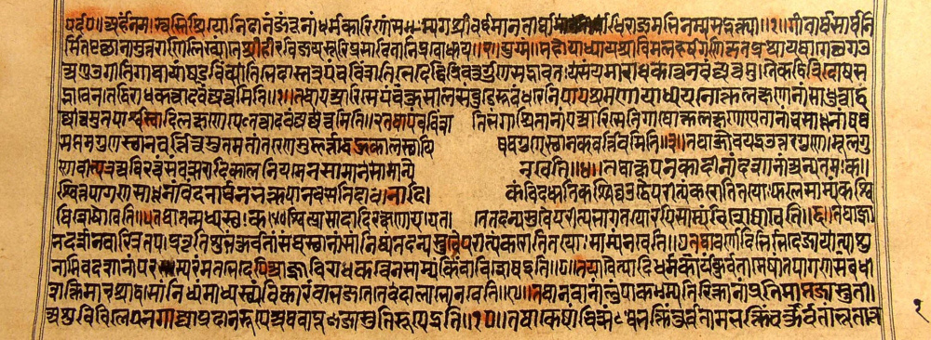
Launguage
Prakrit
- One of the oldest language.
Prakrit
- Used in religious texts and was the language used by common people. Origin and Decline of Prakrit.
7

Slide 8
Credicts
Images: Freepik, Britania, Pinterest. .
Information: Britannica, Jagran Josh.
8

